Slide 1
Display and Share Data
Microsoft Access 2013
Lesson 13

Slide 2
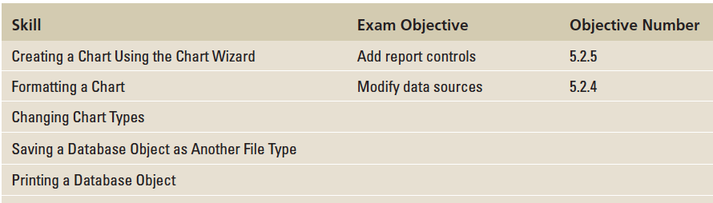
Objectives

Slide 3
Step by Step: Create a Chart
GET READY. Before you begin these steps, be sure to turn on and/or log on to your computer and LAUNCH Access.
OPEN Blue Yonder Airlines from the data files for this lesson.
SAVE the database as Blue Yonder AirlinesXXX (where XXX is your initials).
Open the Income & Expenses report.
Switch to Design view.
On the REPORT DESIGN TOOLS DESIGN tab, in the Controls group, click the Chart button. The pointer changes to a plus sign with a chart icon.

Slide 4
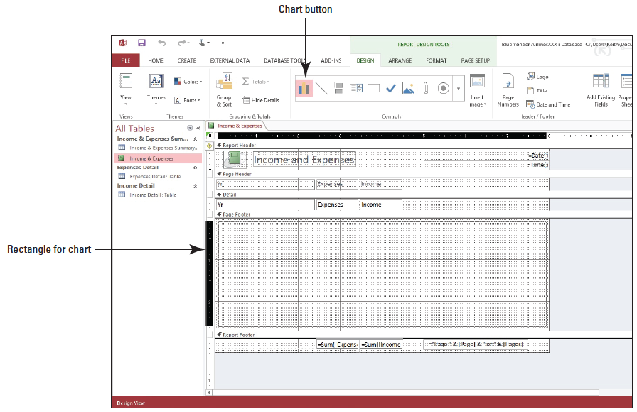
Step by Step: Create a Chart
Click in the upper-left corner of the Page Footer section and drag to the lower-right corner to create a rectangular placeholder where the chart will be inserted, shown below.

Slide 5
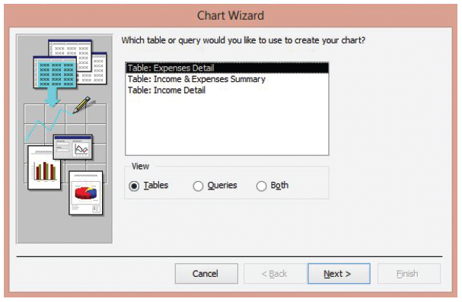
Step by Step: Create a Chart
Release the mouse button. The first Chart Wizard dialog box appears, as shown at right.

Slide 6
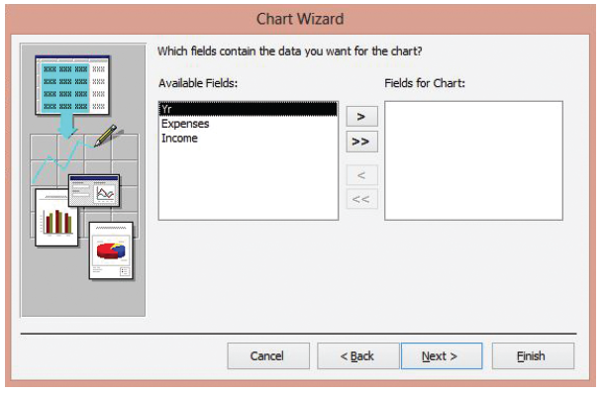
Step by Step: Create a Chart
Select the Income & Expenses Summary table as your data source and click the Next button. The second Chart Wizard dialog box appears, as shown at right.

Slide 7
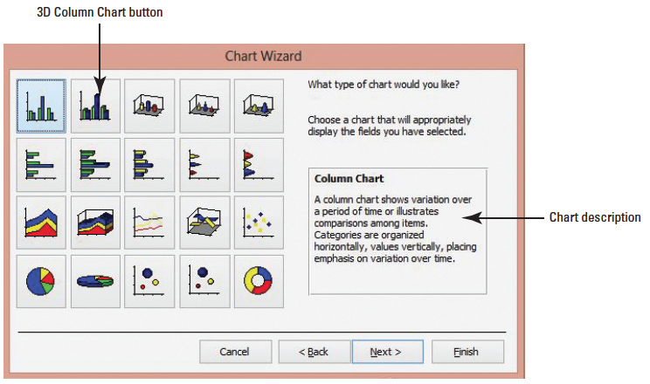
Step by Step: Create a Chart
Click the More (>>) button to move all the fields to the Fields for Chart box and click the Next button. The third Chart Wizard dialog box appears, as shown below.

Slide 8
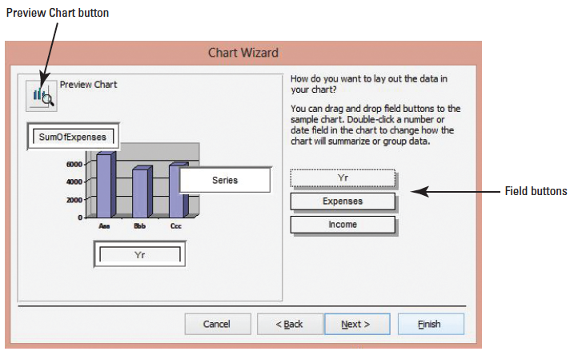
Step by Step: Create a Chart
Click the 3D Column Chart button, the second icon in the first row. Notice that the description of the chart type is displayed on the right.
Click the Next > button. The fourth Chart Wizard dialog box appears, as shown below.

Slide 9
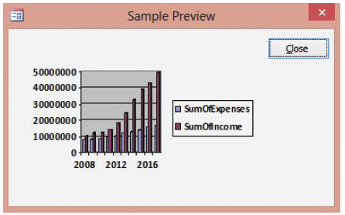
Step by Step: Create a Chart
Click and drag the Income field button to the upper left of the chart and drop on the SumofExpenses data list. Both the SumofExpenses and SumofIncome fields should be listed.
Click the Preview Chart button. The Sample Preview dialog box appears, displaying a sample of your chart, as shown at right.

Slide 10
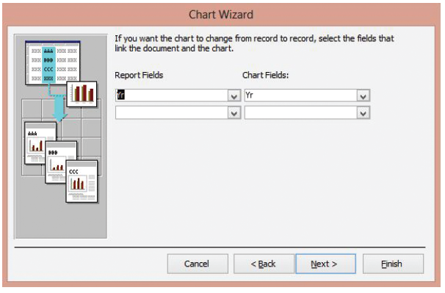
Step by Step: Create a Chart
Click the Close button. The Sample Preview dialog box closes.
Click the Next > button. The fifth Chart Wizard dialog box appears, as shown at right.

Slide 11
Step by Step: Create a Chart
Click the down arrow in the Report Fields menu and select <No Field> since you don’t want to display a chart for each record in the data source.
Click the down arrow in the Chart Fields: menu and select <No Field> again, since you don’t want to display a chart for each record in the data source.

Slide 12
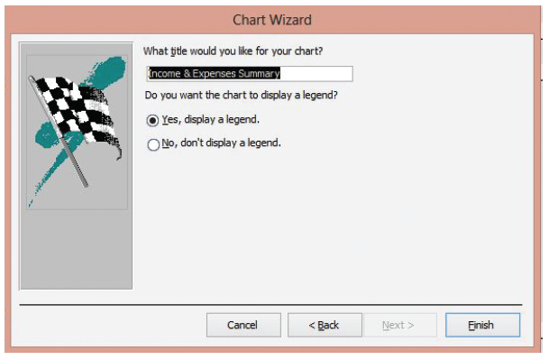
Step by Step: Create a Chart
Click the Next > button. The sixth Chart Wizard dialog box appears, as shown at right.
Key 2008-2017 Income and Expenses in the Title box.

Slide 13
Step by Step: Create a Chart
The Yes, display a legend button should be selected. If not, select it and click the Finish button. Access inserts your chart. Notice that Design view displays sample data and not the actual data from your chart.
Click the chart to select it.
On the REPORT DESIGN TOOLS DESIGN tab, in the Tools group, click the Property Sheet button, if necessary.
Click the DATA tab of the Property Sheet. Click the down arrow at the end of the Enabled cell and select Yes. This enables the chart to accurately display the associated table data.
CLOSE the Property Sheet.
Switch to Report view.

Slide 14
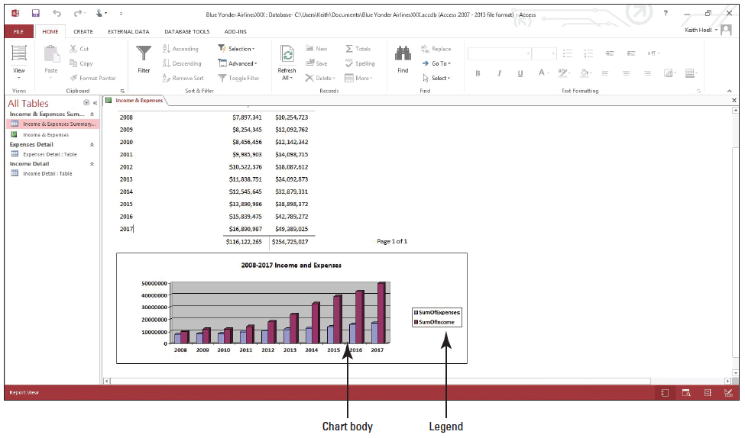
Step by Step: Create a Chart
On the HOME tab, in the Records group, click the Refresh All button to ensure the chart displays the latest table data.
Scroll to the bottom of the report to view your chart, which should look similar to the figure at right.
SAVE the report.
PAUSE. LEAVE the report open to use in the next exercise.
Notes:
Troubleshooting: If your chart is not displaying correctly, you probably need to increase or decrease the width and/or height of the placeholder. You do this the same way you resize any control. Switch to Design view and click the resize handles in the center of the vertical borders and drag to increase or decrease the size. Drag the resize handles on the horizontal borders to change the height. Then, return to Report view to see the results.

Slide 15
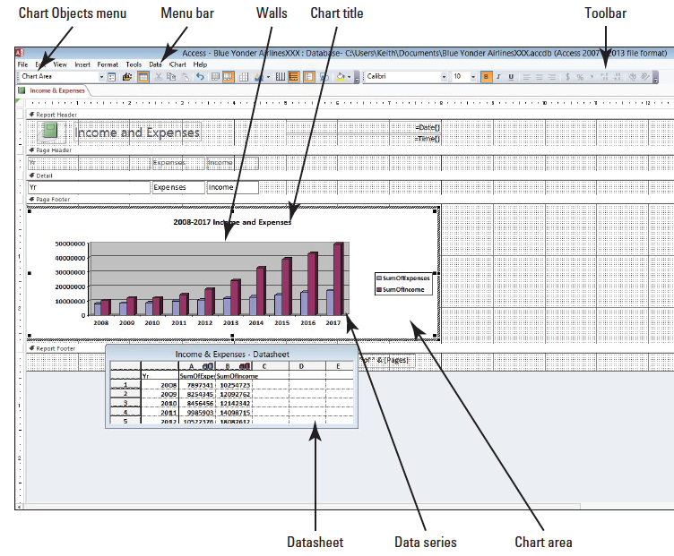
Step by Step: Change Chart Options
USE the report that is open from the previous exercise.
Switch to Design view.
Double-click the chart. The Microsoft Graph software launches, displaying the chart in a view similar to Design view, as shown at right.

Slide 16
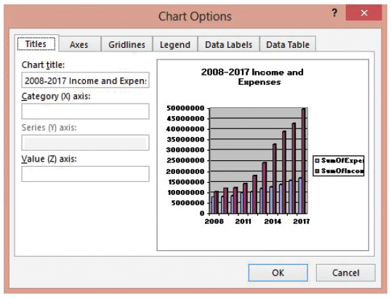
Step by Step: Change Chart Options
Click Chart on the menu bar and select Chart Options from the menu that appears. The Chart Options dialog box appears, as shown at right.

Slide 17
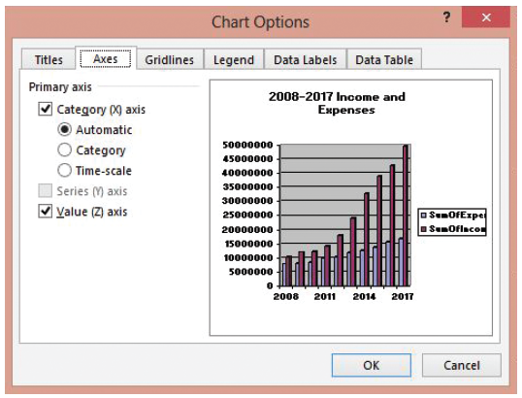
Step by Step: Change Chart Options
Click the Axes tab to display the options on the tab, as shown at right.
Click the Value (Z) axis check box to remove the check mark. Notice that the values on the Z axis are removed.

Slide 18
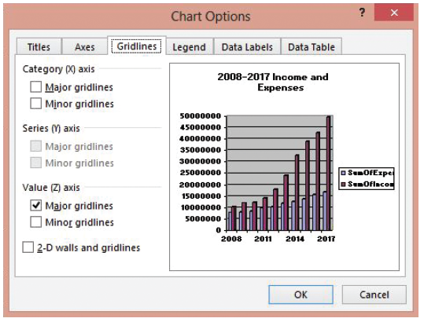
Step by Step: Change Chart Options
Click the Value (Z) axis check box again to insert the check mark.
Click the Gridlines tab to display the options on the tab, as shown at right.

Slide 19
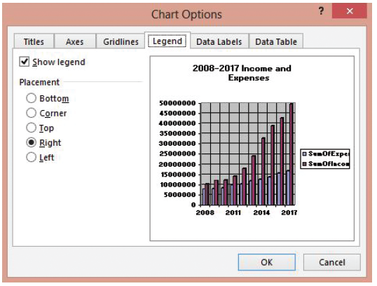
Step by Step: Change Chart Options
Click the Major gridlines check box in the Category (X) axis section. Notice that gridlines are added to the preview.
Click the Legend tab to display the options on the tab, as shown at right.

Slide 20
Step by Step: Change Chart Options
Click the Show legend check box to remove the check mark. Notice that the legend is removed from the chart.
Click the Show legend check box again to insert the check mark. The legend is displayed in the preview.
Click the Bottom option button to move the legend to the bottom of the chart.

Slide 21
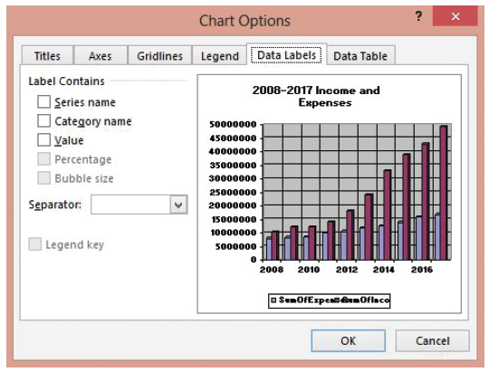
Step by Step: Change Chart Options
Click the Data Labels tab to display the options on the tab, as shown at right.
Click the Value check box to insert a check mark. Notice that values are added to the columns in the chart.

Slide 22
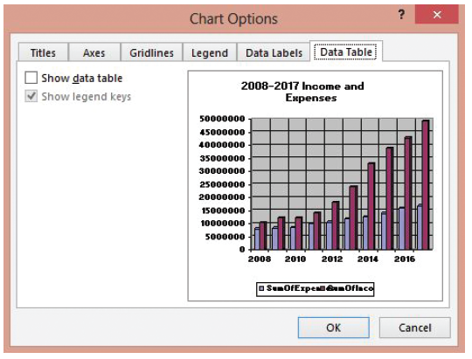
Step by Step: Change Chart Options
Click the Value check box again to remove the check mark.
Click the Data Table tab to display the options on the tab, as shown at right.

Slide 23
Step by Step: Change Chart Options
Click the Show data table check box to insert a check mark. Notice that the datasheet is added to the bottom of the chart.
Click the Show data table check box again to remove the check mark.
Click OK.
Click the File menu and select Save. The Microsoft Graph software closes and the report is switched back to Design view.
PAUSE. LEAVE the report open to use in the next exercise.
Notes:
Troubleshooting: Microsoft Graph has its own Help system. To access it, double-click a chart to launch Microsoft Graph and choose Microsoft Graph Help from the Help menu or press F1.

Slide 24
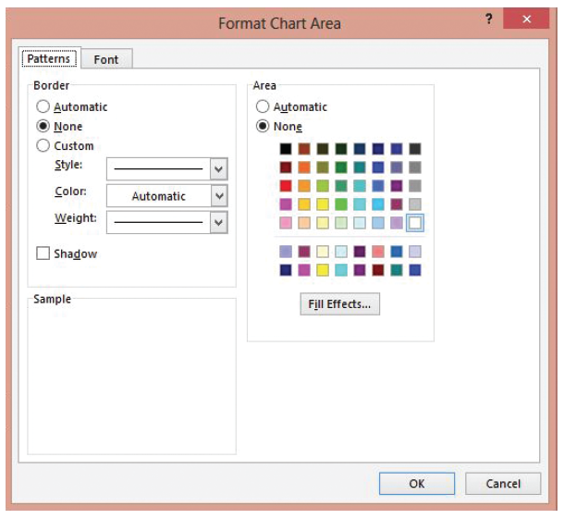
Step by Step: Change Format Options
USE the database that is open from the previous exercise.
Double-click the chart to open Microsoft Graph.
Click the Chart Area, the white background of the chart, to select it. The Chart Area should be displayed in the Chart Objects list box in the upper-left corner of the toolbar.
Click the Format menu and select Selected Chart Area. The Format Chart Area dialog box appears, as shown at right.

Slide 25
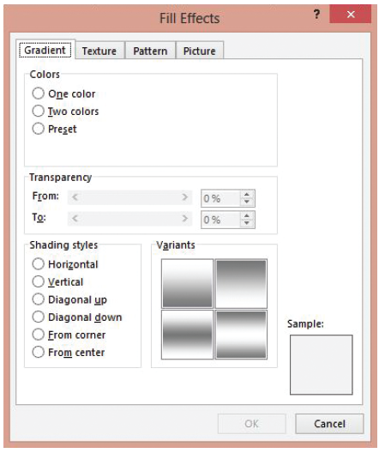
Step by Step: Change Format Options
Click the Fill Effects button. The Fill Effects dialog box appears, as shown at right.
Click the Horizontal option button in the Shading styles section and click OK.

Slide 26
Step by Step: Change Format Options
Click OK in the Format Chart Area dialog box. Notice the shading style of the chart background changes to your selection.
Right-click any of the purple Data Series columns in the chart to display the shortcut menu. Notice that Series “SumOfIncome” is displayed in the Chart Objects list box.
Select Format Data Series from the shortcut menu. The Format Data Series dialog box appears.

Slide 27
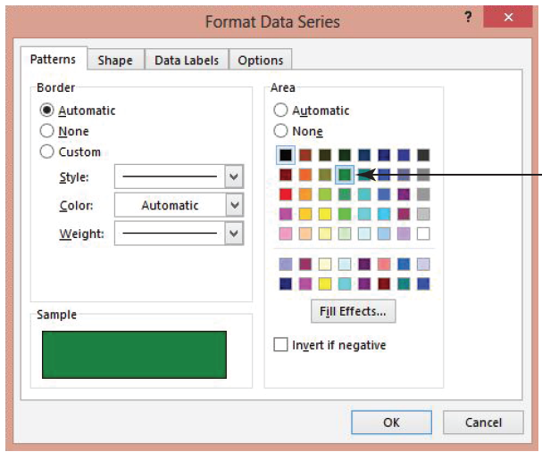
Step by Step: Change Format Options
Select the Green color (second row, fourth from the left) as shown at right.
Click OK in the Format Data Series dialog box.

Slide 28
1 Step by Step: Change Format Options
Right-click the gray grid background of the chart, called the Walls, and select Format Walls from the shortcut menu.
Click the Fill Effects button.
Click the From center button in the Shading styles section and click OK.
Click OK in the Format Walls dialog box.

Slide 29
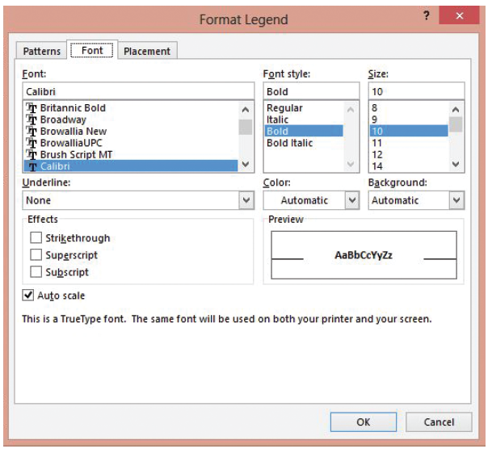
Step by Step: Change Format Options
Right-click the Legend and select Format Legend from the shortcut menu. The Format Legend dialog box appears. Select the Font tab if it is not already displayed. The Font tab menu now appears, as shown at right.

Slide 30
Step by Step: Change Format Options
Select 12 in the Size: menu and click OK. Notice the font size of the legend text has increased.
Click the File menu and select Save. Switch to Report view to view your changes.
SAVE the report.
PAUSE. LEAVE the report open to use in the next exercise.

Slide 31
Step by Step: Refresh Data in a Chart
USE the database that is open from the previous exercise.
OPEN the Income & Expenses Summary table.
In the first row, in the Income column, select the data and key 9004523 and [press Enter].
SAVE and CLOSE the table.
Click the Income & Expenses report tab. Notice that the numbers in the report data and the numbers in the chart have not changed.
On the HOME tab, in the Records group, click the Refresh All button. The data in the report and in the chart are updated.
SAVE the report.
PAUSE. LEAVE the report open to use in the next exercise.

Slide 32
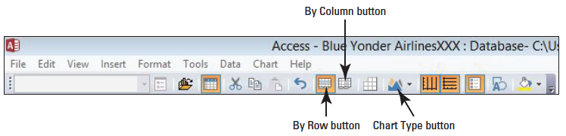
Step by Step: Change Chart Types
USE the database that is open from the previous exercise.
Switch to Design view.
Double-click the chart. Microsoft Graph opens.
Click the By Row button on the toolbar, as shown below. The chart is changed to show all the

Slide 33
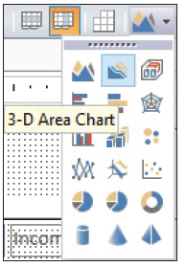
Step by Step: Change Chart Types
Click the By Column button on the toolbar to change it back to the original chart.
Click the Chart Type drop-down arrow in the toolbar and select 3D Area Chart from the menu, as shown at right. The chart changes to an area chart.

Slide 34
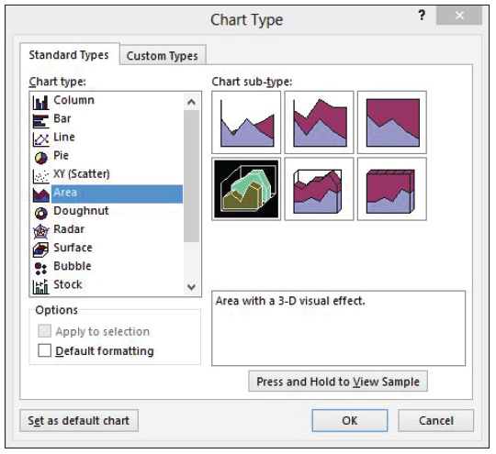
Step by Step: Change Chart Types
Click the Chart menu and select Chart Type. The Chart Type dialog box appears, as shown at right.
On the Standard Types tab, click Pie in the Chart type list. In the Chart sub-type section, click Pie with a 3D visual effect, the second icon on the first row.

Slide 35
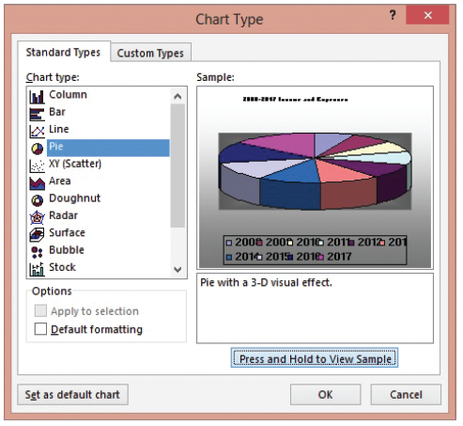
Step by Step: Change Chart Types
Click and hold the Press and Hold to View Sample button to see a preview of the chart, as shown at right.
Click the Custom Types tab.
Click Colored Lines in the Chart type: list and click OK.

Slide 36
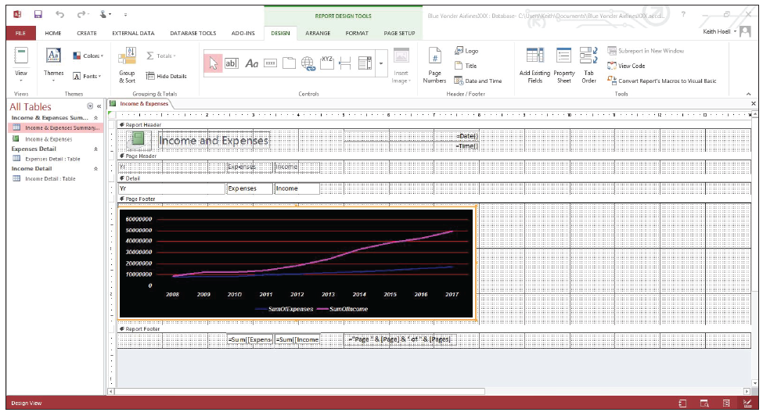
Step by Step: Change Chart Types
Click the File menu and select Save. Your screen should resemble the figure below.
Switch to Report view to view your changes.
SAVE and CLOSE the report.
PAUSE. LEAVE the database open to use in the next exercise.

Slide 37
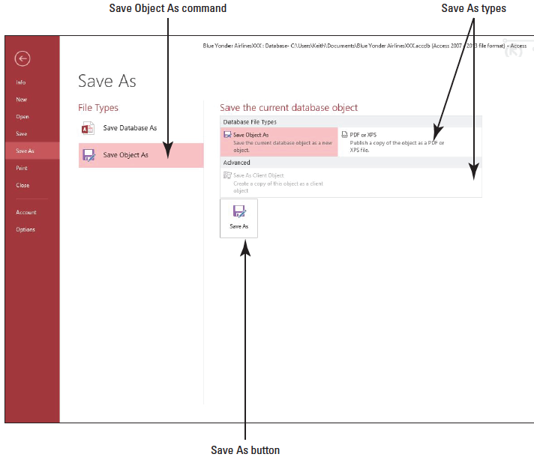
Step by Step: Save a Database Object as Another File Type
USE the database that is open from the previous exercise.
OPEN the Income & Expenses Summary table.
Click the FILE tab, and then click the Save As tab to display the Save As menu. Click the Save Object As command in the File Types category, as shown at right.

Slide 38
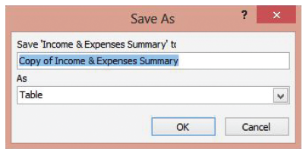
Step by Step: Save a Database Object as Another File Type
Notice the Save Object As option is already highlighted in the Save the current database object category. Click the Save As button. The Save As dialog box appears, as shown at right.
Key Summary Report in the Save box.
Click the down arrow on the As menu and select Report.
Click OK. The table object is saved as a report object and the new Summary Report appears in Layout view.
PAUSE. LEAVE the report open to use in the next exercise.

Slide 39
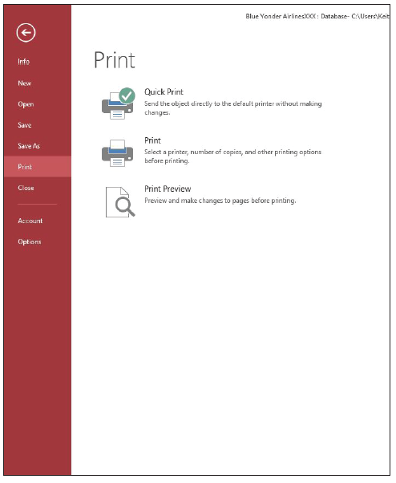
Step by Step: Print a Database Object
USE the report that is open from the previous exercise.
Click the FILE tab and select the Print tab on the menu. The Print tab displays available options, as shown at right.

Slide 40
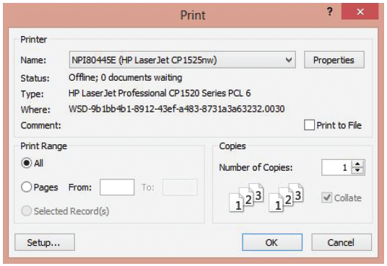
Step by Step: Print a Database Object
Click the Print button. The Print dialog box appears, as shown below.

Slide 41
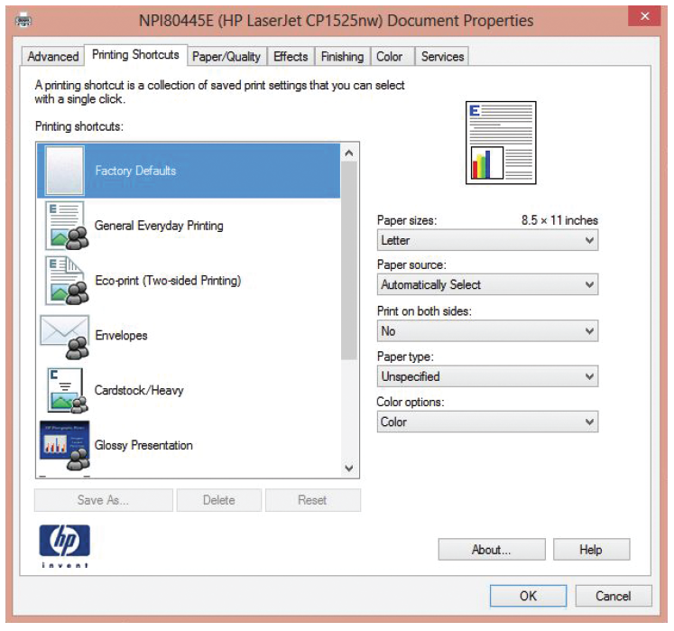
Step by Step: Print a Database Object
Click the Properties button. The Properties dialog box appears, as shown at right. Depending on your type of printer, the Properties dialog box could be different. You can change the quality, paper, printing, and orientation options available for your printer. Click the Cancel button.

Slide 42
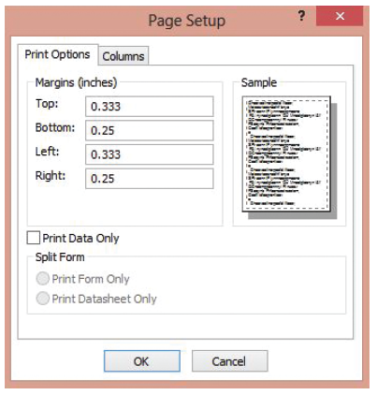
Step by Step: Print a Database Object
Click the Setup button. The Page Setup dialog box appears, as shown at right. Click the Cancel button.
Notes:
Another Way: You can also press Ctrl1P to display the Print dialog box.
Another Way: To print a document quickly, you can skip the Print dialog box and use the default print settings by clicking the Quick Print button, if added, on the Quick Access Toolbar.

Slide 43
Step by Step: Print a Database Object
In the Copies section of the Print dialog box, click the up arrow in the Number of Copies menu to change the number of copies to 2.
Click OK to print two copies of the report, or click Cancel (if you choose not to Print).
CLOSE the report and table.
CLOSE the database.

Slide 44
Skill Summary

